Slide 1
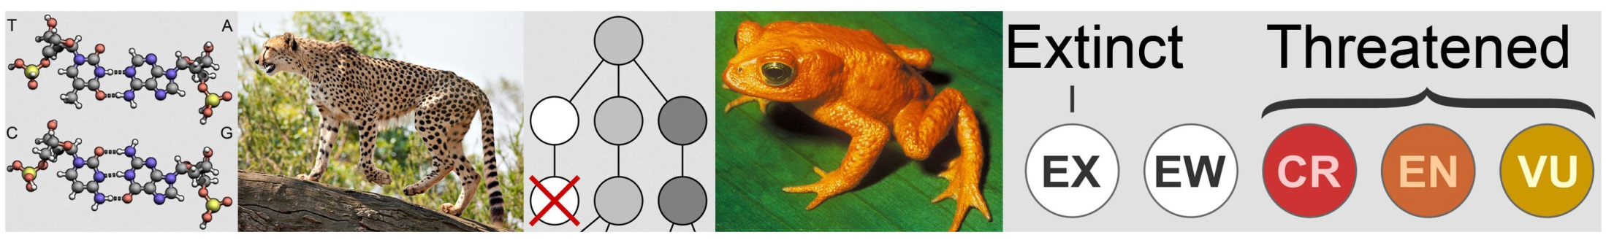

Biol3110: Evolutionary and conservation genetics
Tutorial 2
First hour: More advanced single/few loci questions
Second hour: Introductory quant gen questions

Slide 2
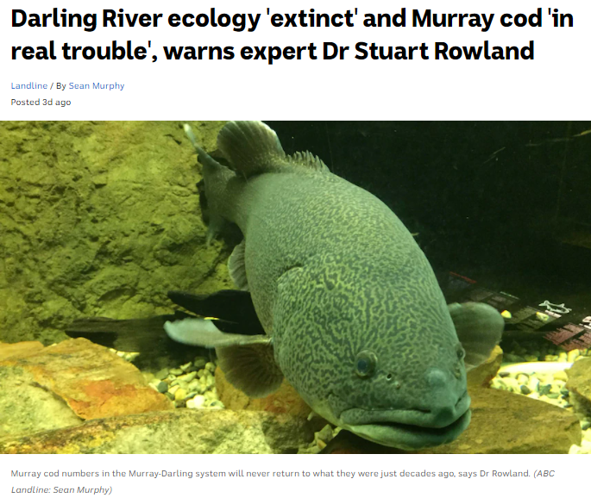
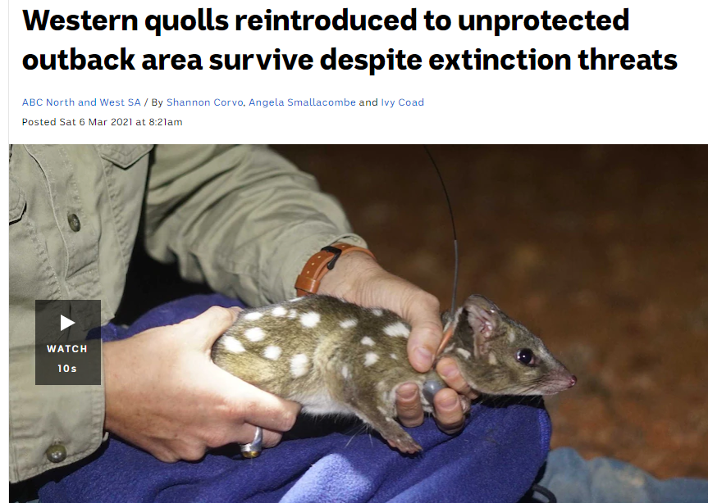
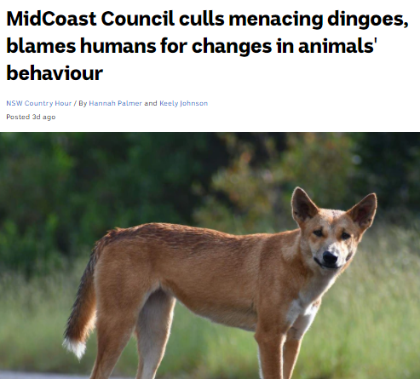

Environmental News
Discuss how can genetics be used to help?

Slide 3
1.1 Chi-square and deviation from Hardy-Weinberg: We are interested in studying coat colouration in unicorns, which is controlled by 3 different alleles segregating at a single locus. We rounded up 320 individuals and found the following breakdown of phenotypes/genotypes:
What are the frequencies (p,q & r) of the three alleles in this case?
What are the Hardy-Weinberg (H-W) expected frequencies of individuals of each genotype?
Does the observed distribution of genotypes in this population vary significantly from the H-W expectation?
What are the values of H_{o} and H_{e} in this case?
Phenotype | White | Grey | Ginger | Bay | Brown | Silver
Genotype | A₁A₁ | A₁A₂ | A₁A₃ | A₂A₂ | A₂A₃ | A₃A₃
Frequency | 120 | 80 | 60 | 40 | 10 | 10

Slide 4
1.1 Chi-square and deviation from Hardy-Weinberg: We are interested in studying coat colouration in unicorns, which is controlled by 3 different alleles segregating at a single locus. We rounded up 320 individuals and found the following breakdown of phenotypes/genotypes:
What are the frequencies (p,q & r) of the three alleles in this case?
Phenotype | White | Grey | Ginger | Bay | Brown | Silver
Genotype | A₁A₁ | A₁A₂ | A₁A₃ | A₂A₂ | A₂A₃ | A₃A₃
Frequency | 120 | 80 | 60 | 40 | 10 | 10
Count the alleles (320 x 2 in total = 640):
Number of A₁: = (120x2)+(1x80)+(1x60)
= 380

Slide 5
1.1 Chi-square and deviation from Hardy-Weinberg: We are interested in studying coat colouration in unicorns, which is controlled by 3 different alleles segregating at a single locus. We rounded up 320 individuals and found the following breakdown of phenotypes/genotypes:
What are the frequencies (p,q & r) of the three alleles in this case?
Phenotype | White | Grey | Ginger | Bay | Brown | Silver
Genotype | A₁A₁ | A₁A₂ | A₁A₃ | A₂A₂ | A₂A₃ | A₃A₃
Frequency | 120 | 80 | 60 | 40 | 10 | 10
Count the alleles (320 x 2 in total = 640):
Number of A₁: = (120x2)+(1x80)+(1x60)
= 380
p = rel freq(A₁) = 380/640 (total alleles)
= 0.5938
q = rel freq (A₂) = (40x2)+80+10/640
= 170/640
= 0.2656
r = rel freq (A₃) = (10x2)+60+10/640
= 0.1406

Slide 6
1.1 Chi-square and deviation from Hardy-Weinberg: We are interested in studying coat colouration in unicorns, which is controlled by 3 different alleles segregating at a single locus. We rounded up 320 individuals and found the following breakdown of phenotypes/genotypes:
What are the frequencies (p,q & r) of the three alleles in this case?
Phenotype | White | Grey | Ginger | Bay | Brown | Silver
Genotype | A₁A₁ | A₁A₂ | A₁A₃ | A₂A₂ | A₂A₃ | A₃A₃
Frequency | 120 | 80 | 60 | 40 | 10 | 10
Count the alleles (320 x 2 in total = 640):
Number of A: = (120x2)+(1x80)+(1x60)
= 380
p = rel freq(A₁) = 380/640 (total alleles)
= 0.5938
q = rel freq (A₂) = (40x2)+80+10/640
= 170/640
= 0.2656
r = rel freq (A₃) = (10x2)+60+10/640
= 0.1406
Always check to see that these relative frequencies sum to 1.0!

Slide 7
1.1 Chi-square and deviation from Hardy-Weinberg: We are interested in studying coat colouration in unicorns, which is controlled by 3 different alleles segregating at a single locus. We rounded up 320 individuals and found the following breakdown of phenotypes/genotypes:
What are the frequencies (p,q & r) of the three alleles in this case?
What are the Hardy-Weinberg (H-W) expected frequencies of individuals of each genotype?
Phenotype | White | Grey | Ginger | Bay | Brown | Silver
Genotype | A₁A₁ | A₁A₂ | A₁A₃ | A₂A₂ | A₂A₃ | A₃A₃
Frequency | 120 | 80 | 60 | 40 | 10 | 10
(b) Work this out using p = 0.5938 q = 0.2656 r = 0.1406 and N = 320:
:
Phenotype | White | Grey | Ginger | Bay | Brown | Silver | SUM
Genotype | A₁A₁ | A₁A₂ | A₁A₃ | A₂A₂ | A₂A₃ | A₃A₃
HW-Expected relative frequencies: | P² | 2pq | 2pr | q² | 2qr | r²

Slide 8
1.1 Chi-square and deviation from Hardy-Weinberg: We are interested in studying coat colouration in unicorns, which is controlled by 3 different alleles segregating at a single locus. We rounded up 320 individuals and found the following breakdown of phenotypes/genotypes:
What are the frequencies (p,q & r) of the three alleles in this case?
What are the Hardy-Weinberg (H-W) expected frequencies of individuals of each genotype?
Phenotype | White | Grey | Ginger | Bay | Brown | Silver
Genotype | A₁A₁ | A₁A₂ | A₁A₃ | A₂A₂ | A₂A₃ | A₃A₃
Frequency | 120 | 80 | 60 | 40 | 10 | 10
(b) Work this out using p = 0.5938 q = 0.2656 r = 0.1406 and N = 320:
:
Phenotype | White | Grey | Ginger | Bay | Brown | Silver | SUM
Genotype | A₁A₁ | A₁A₂ | A₁A₃ | A₂A₂ | A₂A₃ | A₃A₃
HW-Expected relative frequencies: | P² | 2pq | 2pr | q² | 2qr | r²
 | 0.3525 | 0.3154 | 0.1670 | 0.0706 | 0.0747 | 0.0198 | 1.00

Slide 9
1.1 Chi-square and deviation from Hardy-Weinberg: We are interested in studying coat colouration in unicorns, which is controlled by 3 different alleles segregating at a single locus. We rounded up 320 individuals and found the following breakdown of phenotypes/genotypes:
What are the frequencies (p,q & r) of the three alleles in this case?
What are the Hardy-Weinberg (H-W) expected frequencies of individuals of each genotype?
Phenotype | White | Grey | Ginger | Bay | Brown | Silver
Genotype | A₁A₁ | A₁A₂ | A₁A₃ | A₂A₂ | A₂A₃ | A₃A₃
Frequency | 120 | 80 | 60 | 40 | 10 | 10
(b) Work this out using p = 0.5938 q = 0.2656 r = 0.1406 and N = 320:
:
Phenotype | White | Grey | Ginger | Bay | Brown | Silver | SUM
Genotype | A₁A₁ | A₁A₂ | A₁A₃ | A₂A₂ | A₂A₃ | A₃A₃
HW-Expected relative frequencies: | P² | 2pq | 2pr | q² | 2qr | r²
 | 0.3525 | 0.3154 | 0.1670 | 0.0706 | 0.0747 | 0.0198 | 1.00
Expected absolute frequencies:

Slide 10
1.1 Chi-square and deviation from Hardy-Weinberg: We are interested in studying coat colouration in unicorns, which is controlled by 3 different alleles segregating at a single locus. We rounded up 320 individuals and found the following breakdown of phenotypes/genotypes:
What are the frequencies (p,q & r) of the three alleles in this case?
What are the Hardy-Weinberg (H-W) expected frequencies of individuals of each genotype?
Phenotype | White | Grey | Ginger | Bay | Brown | Silver
Genotype | A₁A₁ | A₁A₂ | A₁A₃ | A₂A₂ | A₂A₃ | A₃A₃
Frequency | 120 | 80 | 60 | 40 | 10 | 10
(b) Work this out using p = 0.5938 q = 0.2656 r = 0.1406 and N = 320:
:
Phenotype | White | Grey | Ginger | Bay | Brown | Silver | SUM
Genotype | A₁A₁ | A₁A₂ | A₁A₃ | A₂A₂ | A₂A₃ | A₃A₃
HW-Expected relative frequencies: | P² | 2pq | 2pr | q² | 2qr | r²
 | 0.3525 | 0.3154 | 0.1670 | 0.0706 | 0.0747 | 0.0198 | 1.00
Expected absolute frequencies: | 112.81 | 100.94 | 53.44 | 22.58 | 23.91 | 6.33 | 320

Slide 11
1.1 Chi-square and deviation from Hardy-Weinberg: We are interested in studying coat colouration in unicorns, which is controlled by 3 different alleles segregating at a single locus. We rounded up 320 individuals and found the following breakdown of phenotypes/genotypes:
What are the frequencies (p,q & r) of the three alleles in this case?
What are the Hardy-Weinberg (H-W) expected frequencies of individuals of each genotype?
Does the observed distribution of genotypes in this population vary significantly from the H-W expectation?
Phenotype | White | Grey | Ginger | Bay | Brown | Silver
Genotype | A₁A₁ | A₁A₂ | A₁A₃ | A₂A₂ | A₂A₃ | A₃A₃
Frequency | 120 | 80 | 60 | 40 | 10 | 10
(C) Work out the chi-square statistic:
:
 | White | Grey | Ginger | Bay | Brown | Silver | SUM
HW-Exp: | 112.81 | 100.94 | 53.44 | 22.58 | 23.91 | 6.33 | 320
Obs: | 120 | 80 | 60 | 40 | 10 | 10 | 320
Chi-square:

Slide 12
1.1 Chi-square and deviation from Hardy-Weinberg: We are interested in studying coat colouration in unicorns, which is controlled by 3 different alleles segregating at a single locus. We rounded up 320 individuals and found the following breakdown of phenotypes/genotypes:
What are the frequencies (p,q & r) of the three alleles in this case?
What are the Hardy-Weinberg (H-W) expected frequencies of individuals of each genotype?
Does the observed distribution of genotypes in this population vary significantly from the H-W expectation?
Phenotype | White | Grey | Ginger | Bay | Brown | Silver
Genotype | A₁A₁ | A₁A₂ | A₁A₃ | A₂A₂ | A₂A₃ | A₃A₃
Frequency | 120 | 80 | 60 | 40 | 10 | 10
(C) Work out the chi-square statistic:
:
 | White | Grey | Ginger | Bay | Brown | Silver | SUM
HW-Exp: | 112.81 | 100.94 | 53.44 | 22.58 | 23.91 | 6.33 | 320
Obs: | 120 | 80 | 60 | 40 | 10 | 10 | 320
Chi-square: | (120-112.8)² 112.81 | (80-100.9)² 100.94 | (60-53.44)² 53.44 | (40-22.58)² 22.58 | (10-23.91)² 23.91 | (10-6.33)² 6.33 | 29.27

Slide 13
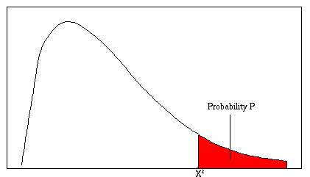
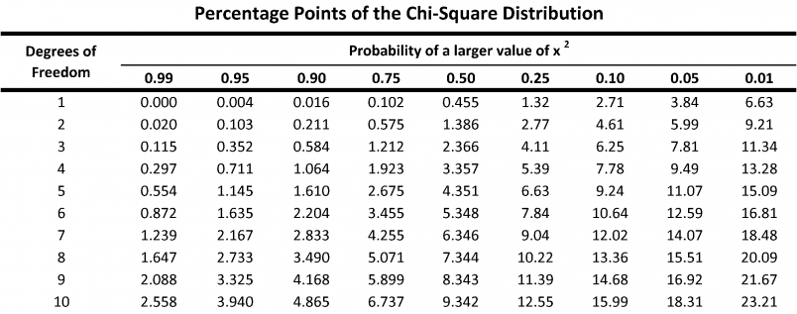
Chi squared table
χ²₃ = 29.27, P < 0.05
Hence, we reject the hypothesis that colour phenotype alleles are distributed according to HW expectations

Slide 14
1.1 Chi-square and deviation from Hardy-Weinberg: We are interested in studying coat colouration in unicorns, which is controlled by 3 different alleles segregating at a single locus. We rounded up 320 individuals and found the following breakdown of phenotypes/genotypes:
What are the frequencies (p,q & r) of the three alleles in this case?
What are the Hardy-Weinberg (H-W) expected frequencies of individuals of each genotype?
Does the observed distribution of genotypes in this population vary significantly from the H-W expectation?
What are the values of H_{o} and H_{e} in this case?
Phenotype | White | Grey | Ginger | Bay | Brown | Silver
Genotype | A₁A₁ | A₁A₂ | A₁A₃ | A₂A₂ | A₂A₃ | A₃A₃
Frequency | 120 | 80 | 60 | 40 | 10 | 10
Part (C): Yes it does deviate from H-W expectation.
Part (d) examine Heterozygosity…
Observed H =
H-W Expected H =

Slide 15
1.1 Chi-square and deviation from Hardy-Weinberg: We are interested in studying coat colouration in unicorns, which is controlled by 3 different alleles segregating at a single locus. We rounded up 320 individuals and found the following breakdown of phenotypes/genotypes:
What are the frequencies (p,q & r) of the three alleles in this case?
What are the Hardy-Weinberg (H-W) expected frequencies of individuals of each genotype?
Does the observed distribution of genotypes in this population vary significantly from the H-W expectation?
What are the values of H_{o} and H_{e} in this case?
Phenotype | White | Grey | Ginger | Bay | Brown | Silver
Genotype | A₁A₁ | A₁A₂ | A₁A₃ | A₂A₂ | A₂A₃ | A₃A₃
Frequency | 120 | 80 | 60 | 40 | 10 | 10
Part (C): Yes it does deviate from H-W expectation.
Part (d) examine Heterozygosity…
Observed H = Pr(heterozygote) = = (A₁A₂+A₁A₃+A₂A₃)/Total
= (80+60+10)/320
= 0.4688
H-W Expected H = 1 – p² – q² – r² = 1- 0.5938² - 0.2656² - 0.1406² = 0.5571

Slide 16
1.1 Chi-square and deviation from Hardy-Weinberg: We are interested in studying coat colouration in unicorns, which is controlled by 3 different alleles segregating at a single locus. We rounded up 320 individuals and found the following breakdown of phenotypes/genotypes:
What are the frequencies (p,q & r) of the three alleles in this case?
What are the Hardy-Weinberg (H-W) expected frequencies of individuals of each genotype?
Does the observed distribution of genotypes in this population vary significantly from the H-W expectation?
What are the values of H_{o} and H_{e} in this case?
Phenotype | White | Grey | Ginger | Bay | Brown | Silver
Genotype | A₁A₁ | A₁A₂ | A₁A₃ | A₂A₂ | A₂A₃ | A₃A₃
Frequency | 120 | 80 | 60 | 40 | 10 | 10
Part (C): Yes it does deviate from H-W expectation.
Part (d) examine Heterozygosity…
Observed H = Pr(heterozygote) = (A₁A₂+A₁A₃+A₂A₃)/Total
= (80+60+10)/320
= 0.4688
H-W Expected H = 1 – (p² + q² + r²) = 1- 0.5938² - 0.2656² - 0.1406²
= 0.5571

Slide 17
1.1 Chi-square and deviation from Hardy-Weinberg: We are interested in studying coat colouration in unicorns, which is controlled by 3 different alleles segregating at a single locus. We rounded up 320 individuals and found the following breakdown of phenotypes/genotypes:
What are the frequencies (p,q & r) of the three alleles in this case?
What are the Hardy-Weinberg (H-W) expected frequencies of individuals of each genotype?
Does the observed distribution of genotypes in this population vary significantly from the H-W expectation?
What are the values of H_{o} and H_{e} in this case?
Phenotype | White | Grey | Ginger | Bay | Brown | Silver
Genotype | A₁A₁ | A₁A₂ | A₁A₃ | A₂A₂ | A₂A₃ | A₃A₃
Frequency | 120 | 80 | 60 | 40 | 10 | 10
(d) H(obs) simply = pr(heterozygote) = 0.4688
H(exp) = 1 – p2 – q2 – r2 = 0.5571
Phenotype | White | Grey | Ginger | Bay | Brown | Silver | SUM
Genotype | A₁A₁ | A₁A₂ | A₁A₃ | A₂A₂ | A₂A₃ | A₃A₃
HW-Exp numbers: | 112.81 | 100.94 | 53.44 | 22.58 | 23.91 | 6.33 | 320
Obs numbers: | 120 | 80 | 60 | 40 | 10 | 10 | 320

Slide 18
1.2 Chi=square and deviation from Hardy-Weinberg: We measured the genotypes for a flower colour polymorphism at a single locus with no dominance, and found the following results:
If we selected a single allele at random, what is the probability that it would be A₂?
Find the frequencies of p & q, and use them to test whether this distribution differs from H-W expectations.
Let’s say we actually samples 10 times as many individuals of each flower colour (i.e. A₁A₁ = 60, A₁A₂ = 110, A₂A₂ = 160). Re-test whether the genotype distributions now deviate from H-W expectations. If so, can you explain why?
Phenotype | Yellow | White | Black
Genotype | A₁A₁ | A₁A₂ | A₂A₂
Frequency | 6 | 11 | 16

Slide 19
1.2 Chi=square and deviation from Hardy-Weinberg: We measured the genotypes for a flower colour polymorphism at a single locus with no dominance, and found the following results:
If we selected a single allele at random, what is the probability that it would be A₂?
Phenotype | Yellow | White | Black
Genotype | A₁A₁ | A₁A₂ | A₂A₂
Frequency | 6 | 11 | 16
This is q: count the alleles
q = ((2 x 16)+11)/(2 x 33) = 0.6515

Slide 20
1.2 Chi=square and deviation from Hardy-Weinberg: We measured the genotypes for a flower colour polymorphism at a single locus with no dominance, and found the following results:
If we selected a single allele at random, what is the probability that it would be A₂?
Find the frequencies of p & q, and use them to test whether this distribution differs from H-W expectations.
Phenotype | Yellow | White | Black
Genotype | A₁A₁ | A₁A₂ | A₂A₂
Frequency | 6 | 11 | 16
p = Frequency of A₁ allele | 0.3485
q = Frequency of A₂ allele | 0.6515
p + q | 1.00
(b)

Slide 21
1.2 Chi=square and deviation from Hardy-Weinberg: We measured the genotypes for a flower colour polymorphism at a single locus with no dominance, and found the following results:
If we selected a single allele at random, what is the probability that it would be A₂?
Find the frequencies of p & q, and use them to test whether this distribution differs from H-W expectations.
Phenotype | Yellow | White | Black
Genotype | A₁A₁ | A₁A₂ | A₂A₂
Frequency | 6 | 11 | 16
(b)
p = Frequency of A₁ allele | 0.3485
q = Frequency of A₂ allele | 0.6515
p + q | 1.00
 | A₁A₁ | A₁A₂ | A₂A₂ | TOTAL
Observed Genotype Counts | 6 | 11 | 16 | 33
 | p² | 2pq | q²
Expected Genotype Frequency | 0.121 | 0.454 | 0.425
Expected Genotype Frequency | 4.006 | 14.985 | 14.009 | 33
Chi-square | 0.992 | 1.060 | 0.283 | 2.335

Slide 22
Chi squared table
1 degree of freedom

Slide 23
1.2 Chi=square and deviation from Hardy-Weinberg: We measured the genotypes for a flower colour polymorphism at a single locus with no dominance, and found the following results:
If we selected a single allele at random, what is the probability that it would be A₂?
Find the frequencies of p & q, and use them to test whether this distribution differs from H-W expectations.
Phenotype | Yellow | White | Black
Genotype | A₁A₁ | A₁A₂ | A₂A₂
Frequency | 6 | 11 | 16
(b)
p = Frequency of A₁ allele | 0.3485
q = Frequency of A₂ allele | 0.6515
p + q | 1.00
 | A₁A₁ | A₁A₂ | A₂A₂ | TOTAL
Observed Genotype Counts | 6 | 11 | 16 | 33
 | p² | 2pq | q²
Expected Genotype Frequency | 0.121 | 0.454 | 0.425
Expected Genotype Frequency | 4.006 | 14.985 | 14.009 | 33
Chi-square | 0.992 | 1.060 | 0.283 | 2.335
Critical value with 1 degree of freedom is 3.84
No evidence to reject HW equilib.

Slide 24

1.2 Chi=square and deviation from Hardy-Weinberg: We measured the genotypes for a flower colour polymorphism at a single locus with no dominance, and found the following results:
If we selected a single allele at random, what is the probability that it would be A₂?
Find the frequencies of p & q, and use them to test whether this distribution differs from H-W expectations.
Let’s say we actually samples 10 times as many individuals of each flower colour (i.e. A₁A₁ = 60, A₁A₂ = 110, A₂A₂ = 160). Re-test whether the genotype distributions now deviate from H-W expectations. If so, can you explain why?
Phenotype | Yellow | White | Black
Genotype | A₁A₁ | A₁A₂ | A₂A₂
Frequency | 6 | 11 | 16
p = Frequency of A₁ allele | 0.3485
q = Frequency of A₂ allele | 0.6515
p + q | 1.00
(c)
 | A₁A₁ | A₁A₂ | A₂A₂ | TOTAL

Slide 25
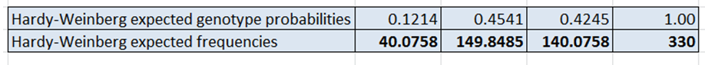
1.2 Chi=square and deviation from Hardy-Weinberg: We measured the genotypes for a flower colour polymorphism at a single locus with no dominance, and found the following results:
If we selected a single allele at random, what is the probability that it would be A₂?
Find the frequencies of p & q, and use them to test whether this distribution differs from H-W expectations.
Let’s say we actually samples 10 times as many individuals of each flower colour (i.e. A₁A₁ = 60, A₁A₂ = 110, A₂A₂ = 160). Re-test whether the genotype distributions now deviate from H-W expectations. If so, can you explain why?
Phenotype | Yellow | White | Black
Genotype | A₁A₁ | A₁A₂ | A₂A₂
Frequency | 6 | 11 | 16
p = Frequency of A₁ allele | 0.3485
q = Frequency of A₂ allele | 0.6515
p + q | 1.00
(c)
 | A₁A₁ | A₁A₂ | A₂A₂ | TOTAL
Chai-square ∑(OBS-EXP)²/EXP | 9.9056 | 10.5967 | 2.8340 | 23.336
Chi-square critical value for 1 d.f. |  |  |  | 3.84
But now we
do reject it
Why?

Slide 26
1.3 Hardy-Weinberg and dominance: We collected 460 samples of an orchid species but as the A₁ allele is completely dominant over the deleterious recessive A₂ allele, we could only assign the genotypes among the phenotypes as follows:
If we knew that the alleles were in H-W equilibrium at this locus, can you estimate the relative frequency of the A₂ allele?
What processes could keep a recessive allele at high frequency in a population?
Phenotype | Yellow | Black
Genotype | A₁A₁ or A₁A₂ | A₂A₂
Frequency | 340 | 120

Slide 27
1.3 Hardy-Weinberg and dominance: We collected 460 samples of an orchid species but as the A₁ allele is completely dominant over the deleterious recessive A₂ allele, we could only assign the genotypes among the phenotypes as follows:
If we knew that the alleles were in H-W equilibrium at this locus, can you estimate the relative frequency of the A₂ allele?
What processes could keep a deleterious recessive allele at high frequency in a population?
Phenotype | Yellow | Black
Genotype | A₁A₁ or A₁A₂ | A₂A₂
Frequency | 340 | 120
(a) This is simply q. At H-W equilibrium:
q² = 120/(120+340) = 0.2609
q = sqrt(0.2609)
q = 0.5108 therefore
(b) Ideas?
A₁A₁ (P²) | A₁A₂ (2pq) | A₂A₂ (q²)
0.2393 | 0.4998 | 0.2609

Slide 28
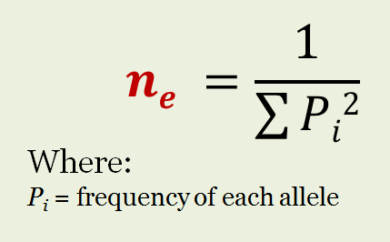
Effective Number of Alleles
The number of alleles that if equally frequent
would result in the observed heterozygosity
Less sensitive to sample size
• Less influenced by rare alleles
• Highest when more alleles present but at
equal frequencies
BIOL3110 Tutorial 2

Slide 29
1.4 Allele frequencies: A group of conservation biologists sequenced two different microsatellite markers in a population of Kakapo’s in New Zealand. They found the following allelic variation:
Calculate polymorphism (P), average allelic diversity (A), and n_{e} for each complex of five loci (average the individual n_{e} values across loci)
What does the difference between these estimates across each group of microsatellites tell us about the utility of each calculation in describing genetic diversity?
 | Microsatellites (a)
Locus | Allele 1 | Allele 2 | Allele 3 | Allele 4 | Allele 5
1 | 0.8 | 0.1 | 0.05 | 0.025 | 0.025
2 | 0.6 | 0.2 | 0.1 | 0.1
3 | 0.7 | 0.3
4 | 0.8 | 0.2
5 | 1
Microsatellites (b)
Allele 1 | Allele 2 | Allele 3 | Allele 4 | Allele 5
0.3 | 0.2 | 0.2 | 0.2 | 0.1
0.4 | 0.2 | 0.2 | 0.2
0.6 | 0.4
0.7 | 0.3
1

Slide 30
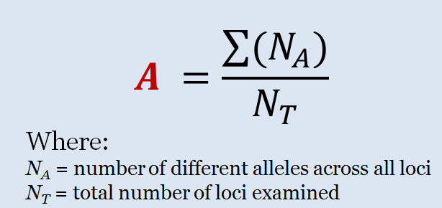
1.4 Allele frequencies: A group of conservation biologists sequenced two different microsatellite markers in a population of Kakapo’s in New Zealand. They found the following allelic variation:
Calculate polymorphism (P), average allelic diversity (A), and n_{e} for each complex of five loci (average the individual n_{e} values across loci)
 | Microsatellites (a)
Locus | Allele 1 | Allele 2 | Allele 3 | Allele 4 | Allele 5
1 | 0.8 | 0.1 | 0.05 | 0.025 | 0.025
2 | 0.6 | 0.2 | 0.1 | 0.1
3 | 0.7 | 0.3
4 | 0.8 | 0.2
5 | 1
Microsatellites (b)
Allele 1 | Allele 2 | Allele 3 | Allele 4 | Allele 5
0.3 | 0.2 | 0.2 | 0.2 | 0.1
0.4 | 0.2 | 0.2 | 0.2
0.6 | 0.4
0.7 | 0.3
1

Slide 31
1.4 Allele frequencies: A group of conservation biologists sequenced two different microsatellite markers in a population of Kakapo’s in New Zealand. They found the following allelic variation:
Calculate polymorphism (P), average allelic diversity (A), and n_{e} for each complex of five loci (average the individual n_{e} values across loci)
 | Microsatellites (a)
Locus | Allele 1 | Allele 2 | Allele 3 | Allele 4 | Allele 5
1 | 0.8 | 0.1 | 0.05 | 0.025 | 0.025
2 | 0.6 | 0.2 | 0.1 | 0.1
3 | 0.7 | 0.3
4 | 0.8 | 0.2
5 | 1
Microsatellites (b)
Allele 1 | Allele 2 | Allele 3 | Allele 4 | Allele 5
0.3 | 0.2 | 0.2 | 0.2 | 0.1
0.4 | 0.2 | 0.2 | 0.2
0.6 | 0.4
0.7 | 0.3
1
For microsatellites (a):
Locus | A1 | A2 | A3 | A4 | A5 | SUM | A | n_{e}
1 | 0.8 | 0.1 | 0.05 | 0.025 | 0.025 | 1.00 | 5 | 1.53
2 | 0.6 | 0.2 | 0.1 | 0.1 |  | 1.00 | 4 | 2.38
3 | 0.7 | 0.3 |  |  |  | 1.00 | 2 | 1.72
4 | 0.8 | 0.2 |  |  |  | 1.00 | 2 | 1.47
5 | 1.0 |  |  |  |  | 1.00 | 1 | 1.00
 |  |  |  |  | Total: | 5 | 14 | 8.105
P = 4/5 = 0.8
A = 14 / 5 = 2.8
n_{e} = 8.105 / 5 = 1.621

Slide 32
1.4 Allele frequencies: A group of conservation biologists sequenced two different microsatellite markers in a population of Kakapo’s in New Zealand. They found the following allelic variation:
Calculate polymorphism (P), average allelic diversity (A), and n_{e} for each complex of five loci (average the individual n_{e} values across loci)
What does the difference between these estimates across each group of microsatellites tell us about the utility of each calculation in describing genetic diversity?
 | Microsatellites (a)
Locus | Allele 1 | Allele 2 | Allele 3 | Allele 4 | Allele 5
1 | 0.8 | 0.1 | 0.05 | 0.025 | 0.025
2 | 0.6 | 0.2 | 0.1 | 0.1
3 | 0.7 | 0.3
4 | 0.8 | 0.2
5 | 1
Microsatellites (b)
Allele 1 | Allele 2 | Allele 3 | Allele 4 | Allele 5
0.3 | 0.2 | 0.2 | 0.2 | 0.1
0.4 | 0.2 | 0.2 | 0.2
0.6 | 0.4
0.7 | 0.3
1
P = 4/5 = 0.8 |  | P = 4/5 = 0.8
A = 14/ 5 = 2.8 |  | A = 14/5 = 2.8
n_{e} = 8.105/ 5 = 1.621 |  | n_{e} = 12.76/5 = 2.55

Slide 33
1.5 Allele diversity: If we study a single polymorphic locus in a population that has 4 alleles, what are the relative frequencies of each allele that yield the highest possible value of n_{e}? What is the maximum value?

Slide 34
1.5 Allele diversity: If we study a single polymorphic locus in a population that has 4 alleles, what are the relative frequencies of each allele that yield the highest possible value of n_{e}? What is the maximum value?
*Clues*
Allelic frequency must sum to 1
n_{e} is highest when allelic frequency is evenly distributed across all alleles
Maximum number of n_{e} is the number of alleles present

Slide 35
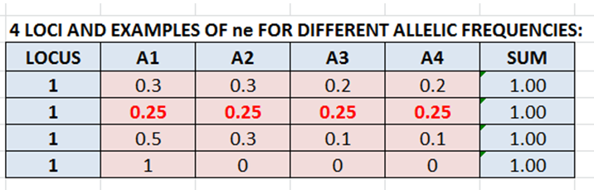
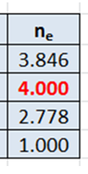
1.5 Allele diversity: If we study a single polymorphic locus in a population that has 4 alleles, what are the relative frequencies of each allele that yield the highest possible value of n_{e}? What is the maximum value?
Allele frequencies are all 0.25 for maximum n_{e}, which is 4.0.

Slide 36
1.6 Linkage disequilibrium: What is the linkage disequilibrium (D) in a population with the following gametic frequencies? What will the frequencies be at equilibrium?
To answer this you will need to refer to the formulae, approach and resources provided in pages 83-85 of Frankham et al.
 | A₁B₁ | A₁B₂ | A₂B₁ | A₂B₂
Frequency | 0.2 | 0.5 | 0.2 | 0.1
Occurs when alleles assort non-randomly
In large, outbred populations, this normally results from strong selection (e.g. mate preference & trait alleles in sexual selection) In small or admixed populations, this can be indicative of bottlenecks or recent pop mixing.
D as (r x u) – (s x t)
(same x same) – (different x different)
*maximum D deviates from zero up to a maximum of ± 0.25

Slide 37
1.6 Linkage disequilibrium: What is the linkage disequilibrium (D) in a population with the following gametic frequencies? What will the frequencies be at equilibrium?
To answer this you will need to refer to the formulae, approach and resources provided in pages 83-85 of Frankham et al.
 | A₁B₁ | A₁B₂ | A₂B₁ | A₂B₂
Frequency | 0.2 | 0.5 | 0.2 | 0.1
For the first part, it is just a matter of calculating:
D as (r x u) – (s x t) = -0.08
 | A₁B₁ | A₁B₂ | A₂B₁ | A₂B₂
Observed frequency | r | s | t | u
 | 0.2 | 0.5 | 0.2 | 0.1

Slide 38
1.6 Linkage disequilibrium: What is the linkage disequilibrium (D) in a population with the following gametic frequencies? What will the frequencies be at equilibrium?
To answer this you will need to refer to the formulae, approach and resources provided in pages 83-85 of Frankham et al.
 | A₁B₁ | A₁B₂ | A₂B₁ | A₂B₂
Frequency | 0.2 | 0.5 | 0.2 | 0.1
We are asking what are the GAMETIC frequencies at EQ. (i.e. D = 0)
Remember, the allele frequencies remain fixed!
So calculate D = 0 given fixed proportions of each alleles (allele freqs)
 | A₁B₁ | A₁B₂ | A₂B₁ | A₂B₂
Observed frequency | r | s | t | u
 | 0.2 | 0.5 | 0.2 | 0.1

Slide 39
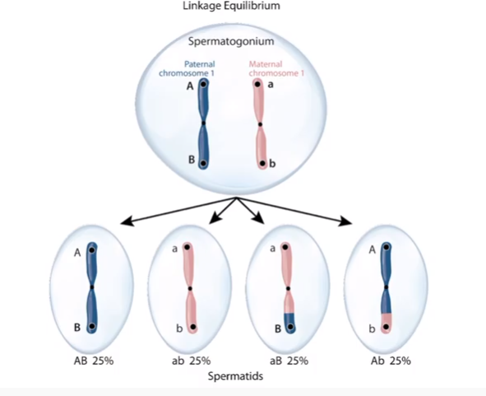
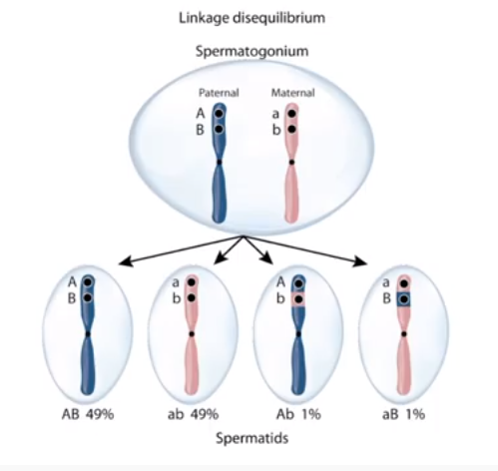
1.6 Linkage disequilibrium: What is the linkage disequilibrium (D) in a population with the following gametic frequencies? What will the frequencies be at equilibrium?
To answer this you will need to refer to the formulae, approach and resources provided in pages 83-85 of Frankham et al.
At equilibrium, alleles are randomly assorted.
VS

Slide 40
1.6 Linkage disequilibrium: What is the linkage disequilibrium (D) in a population with the following gametic frequencies? What will the frequencies be at equilibrium?
To answer this you will need to refer to the formulae, approach and resources provided in pages 83-85 of Frankham et al.
At equilibrium, alleles are randomly assorted.
i.e. Rules of probability apply:
When we are looking at the probability of either A OR B occurring, we ADD. Counting alleles corresponds to asking if alleles are occurring in either of the two genotypes.
When looking at probability of both A AND B occurring we MULTIPLY.
The probability of two alleles occurring in a single particular genotype. (r,u,s,t)
BIOL3110 Tutorial 2

Slide 41
1.6 Linkage disequilibrium: What is the linkage disequilibrium (D) in a population with the following gametic frequencies? What will the frequencies be at equilibrium?
To answer this you will need to refer to the formulae, approach and resources provided in pages 83-85 of Frankham et al.
 | A₁B₁ | A₁B₂ | A₂B₁ | A₂B₂
Frequency | 0.2 | 0.5 | 0.2 | 0.1
Therefore, we need to count alleles to estimate their frequencies:
Frequency of A₁ (aka p_{A}) = 0.2 + 0.5 = 0.7
Frequency of A₂ (aka q_{A}) = 0.2 + 0.1 = 0.3 (or 1-p_{A})
Frequency of B₁ (aka p_{B}) = 0.2 + 0.2 = 0.4
Frequency of B₂ (aka q_{B}) = 0.5 + 0.1 = 0.6 (or 1-p_{B})

Slide 42
1.6 Linkage disequilibrium: What is the linkage disequilibrium (D) in a population with the following gametic frequencies? What will the frequencies be at equilibrium?
To answer this you will need to refer to the formulae, approach and resources provided in pages 83-85 of Frankham et al.
We then MULTPLY the allele frequencies to find the probability of two alleles occurring in a single particular gamete :
r = expected random pair ups of A1 and B1 (A1 X B1)
u = expected random pair ups of A2 and B2 (A2 X B2)
s = expected random pair ups of A1 and B2 (A1 X B2)
t = expected random pair ups of A2 and B1 (A2 X B1)
A₁B₁: 0.7 x 0.4 = 0.28
A₁B₂: 0.7 x 0.6 = 0.42
A₂B₁: 0.3 x 0.4 = 0.12
A₂B₂: 0.3 x 0.6 = 0.18
BIOL3110 Tutorial 2

Slide 43
1.6 Linkage disequilibrium: What is the linkage disequilibrium (D) in a population with the following gametic frequencies? What will the frequencies be at equilibrium?
To answer this you will need to refer to the formulae, approach and resources provided in pages 83-85 of Frankham et al.
We then MULTPLY the allele frequencies to find the probability of two alleles occurring in a single particular gamete :
r = expected random pair ups of A1 and B1 (A1 X B1)
u = expected random pair ups of A2 and B2 (A2 X B2)
s = expected random pair ups of A1 and B2 (A1 X B2)
t = expected random pair ups of A2 and B1 (A2 X B1)
A₁B₁: 0.7 x 0.4 = 0.28
A₁B₂: 0.7 x 0.6 = 0.42
A₂B₁: 0.3 x 0.4 = 0.12
A₂B₂: 0.3 x 0.6 = 0.18
Randomly select an allele from each gene
A Gene
B Gene
BIOL3110 Tutorial 2

Slide 44
1.6 Linkage disequilibrium: What is the linkage disequilibrium (D) in a population with the following gametic frequencies? What will the frequencies be at equilibrium?
To answer this you will need to refer to the formulae, approach and resources provided in pages 83-85 of Frankham et al.
 | A₁B₁ | A₁B₂ | A₂B₁ | A₂B₂
Frequency | 0.2 | 0.5 | 0.2 | 0.1
At equilibrium:
ru – st = 0
(0.28 x 0.18) – (0.42 x 0.12)
= 0.0504 – 0.0504
= 0
To Check
r (A₁B₁) = 0.28
s (A₁B₂) = 0.42
t (A₂B₁) = 0.12
u (A₂B₂) = 0.18

Slide 45
1.7 Hardy-Weinberg equilibrium for a sex-linked locus: If the frequencies of two alleles (A and B) are at H-W equilibrium for an X-linked gene in Baboons, and the frequency of the X¹ allele (p) = 0.62 - complete the following table of relative genotype frequencies:
To answer this you will need to refer to the formulae and examples on pages 80-82 of Frankham et al.
Gender | Females |  |  | Males
Genotype | X¹X¹ | X¹X² | X²X² | X¹Y | X²Y
Relative Frequency

Slide 46
1.7 Hardy-Weinberg equilibrium for a sex-linked locus: If the frequencies of two alleles (A and B) are at H-W equilibrium for an X-linked gene in Baboons, and the frequency of the X¹ allele (p) = 0.62 - complete the following table of relative genotype frequencies:
To answer this you will need to refer to the formulae and examples on pages 80-82 of Frankham et al.
Sex | Females |  |  | Males
Genotype | X¹X¹ | X¹X² | X²X² | X¹Y | X²Y
Relative Frequency
p = relative frequency X¹ | 0.62
q = relative frequency X² | 0.38

Slide 47
1.7 Hardy-Weinberg equilibrium for a sex-linked locus: If the frequencies of two alleles (A and B) are at H-W equilibrium for an X-linked gene in Baboons, and the frequency of the X¹ allele (p) = 0.62 - complete the following table of relative genotype frequencies:
To answer this you will need to refer to the formulae and examples on pages 80-82 of Frankham et al.
Gender | Females |  |  | Males
Genotype | X¹X¹ | X¹X² | X²X² | X¹Y | X²Y
Relative Frequency
Sex-linked X:
p = relative frequency X¹ | 0.62
q = relative frequency X² | 0.38
Gender | Females |  |  | Males
Genotype | X¹X¹ | X¹X² | X²X² | X¹Y | X²Y
Relative Frequency | p² 0.384 | 2pq 0.471 | q² 0.144 | p 0.620 | q 0.380

Slide 48
Heritability
What Does it Measure?
Measure of how much variation in a phenotype is caused by variation in genotype
V_{P} = V_{G} + V_{E}
H² = V_{G}/V_{P}
Proportion of Genetic variance to Phenotypic variance
Environmental Variance (V_{E})
Genetic Variance
V_{G}

Slide 49
Types of Genetic Variance
V_{P} = Phenotypic Variance
V_{E} = Environmental Variance
V_{D} = Dominance Variance
V_{I} = Epistatic Variance
V_{A} = Additive Genetic Variance
V_{E}
V_{P}
V_{D+I}
V_{G}
V_{G} = V_{A} + V_{I} + V_{D}
V_{P} = V_{E} + V_{G}
V_{P} = V_{E} +V_{A} + V_{I} + V_{D}
V_{A}
Notes:
Epistasis occurs when genes at two different loci interact to affect the expression of a single trait. A gene can either mask or modify the phenotype controlled by the other gene.
Labrador coat colour – Black (BBEE or BBEe), brown (BbEE or Bb Ee), Yellow (BBee or Bbee) as yellow gene represses melanin in the dominant recessive form.

Slide 50
Genotypic Variance (VG)
VG = VA + VD + VI
VA = Additive Genetic variance (Additive)
Visible in the next generation AND at subsequent generations (Consistently inherited)
VD = Dominance genetic variance (Non-additive)
Interaction at alleles at a single locus
VI = Epistatic genetic variance (Non-additive)
Interaction of alleles at different loci
The effects of dominant and epistatic interactions reset every time alleles pair together, and so these types of variation are not inherited. They are considered non-additive.

Slide 51
Need to Know Formulae
Broad Sense
V_{P} = V_{G} + V_{E}
H² = V_{G}/V_{P}
Narrow Sense
V_{P} = V_{G} + V_{E}
V_{G} = V_{A} + V_{D} + V_{I}
h² = V_{A}/V_{P}
V_{P} = phenotypic variance
V_{E} = environmental variance
V_{G} = genotypic variance
V_{A} = additive genetic variance
V_{I} = epistatic genetic variance
V_{D} = dominance genetic variance
H² = broad heritability
h² = narrow heritability

Slide 52

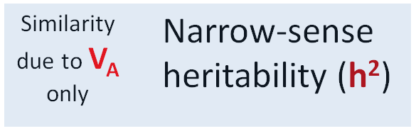

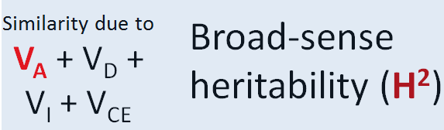
Estimating heritability:
If the environments are standardized, then:
Similarity of parents & offspring:
Similarity between full siblings:
Father Son
E
Sib A Sib B

Slide 53
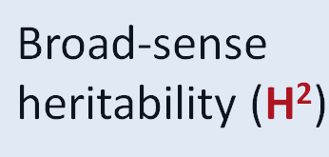
H² from full sib resemblance:
H² ~ V_{G /} V_{p}
~ [V_{A} + V_{D} + V_{I}] / V_{p}
Where V_{D} and V_{I} are non-additive components of V_{G}:
V_{D} = Dominance variance (interactions at same loci)
V_{I} = Epistasis variance (interactions at different loci)
ESTIMATED via ANOVA or Linear Modelling
Sib A Sib B

Slide 54
Estimating heritability:
FULL SIBS: Broad sense heritability: H² ~ (V_{A} + V_{D} +V_{I} + V_{E}) / V_{p}
Where:
V_{A} = Additive genetic variance
V_{D} = Dominance variance (interactions between alleles at the same loci)
V_{I} = Interaction variance (or epistasis - interactions between alleles at different loci)
V_{E} = Environment variance (due to the similarity of developmental environments)
PARENT-OFFSPRING: Narrow-sense heritability: h² ~ V_{A} / V_{p}
So, h² always ≤ H²

Slide 55
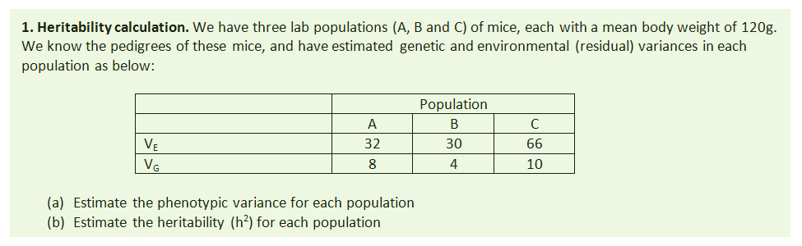
 | Population A | Population B | Population C
V_{E} | 30 | 27 | 60
V_{I+D} | 2 | 3 | 4
V_{A} | 8 | 4 | 10

Slide 56
 | Population A | Population B | Population C
V_{E} | 30 | 27 | 60
V_{I+D} | 2 | 3 | 4
V_{A} | 8 | 4 | 10
H²
 | Population A | Population B | Population C
V_{E} | 30 | 27 | 60
V_{I+D} | 2 | 3 | 4
V_{A} | 8 | 4 | 10
Vp = V_{E} + V_{G} | 40 | 34 | 74

Slide 57
 | Population A | Population B | Population C
V_{E} | 30 | 27 | 60
V_{I+D} | 2 | 3 | 4
V_{A} | 8 | 4 | 10
H²
 | Population A | Population B | Population C
V_{E} | 30 | 27 | 60
V_{I+D} | 2 | 3 | 4
V_{A} | 8 | 4 | 10
Vp = V_{E} + V_{G} | 40 | 34 | 76
h² = V_{A} / V_{P} | 0.200 | 0.1176 | 0.1351

Slide 58
Breeders Equation
What does it do?
A prediction of evolutionary change
Takes in to account:
The selection differential (causal strength of selection)
Heritability (causal strength of genetics)
Needs to be heritable for selection to act on it
R = h²S
Where R is Response to selection
If h² =1?
If h² = 0?

Slide 59
Breeders Equation
What does it do?
A prediction of evolutionary change
Takes in to account:
The selection differential (causal strength of selection)
Heritability (causal strength of genetics)
Needs to be heritable for selection to act on it
R = h²S
Where R is Response to selection
If h² =1? – the trait is completely heritable, R=S
If h² = 0? – selection has nothing to act on!

Slide 60
Selection Differential (S)
What does it measure?
Measure of change in the trait due to selection
Difference between the trait means
S = (selected mean) – (whole population mean)

Slide 61
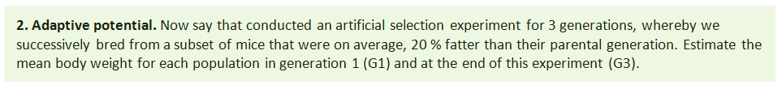
*Using the 3 lab populations from question 1
We need to use the breeder’s equation:
R = h²S
to predict how each population evolves in each generation. The selection differential (S) is the difference between the weight of selected breeders versus the original population.

Slide 62
(G0: Mean weight = 120 g)
Breeder’s equation: R = h²S
The selection differential (S) is the difference in weight between the selected breeders versus the original population.

Slide 63
(G0: Mean weight = 120 g)
Breeder’s equation: R = h²S
The selection differential (S) is the difference in weight between the selected breeders versus the original population.
In G1 the weight of selected breeders for each population is:
120+ (120 x 0.2) = 144
The selection differential (S) is therefore:
144 – 120 = 24
(or simply 120 x 0.2!)

Slide 64
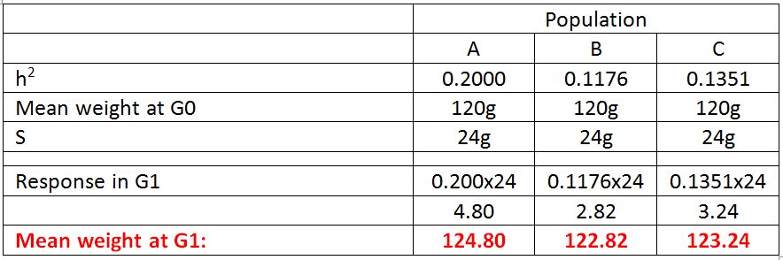
After the first generation of selection (i.e. in G1):
R = h²S
= calculated from Q1

Slide 65
After the first generation of selection (i.e. in G1):
R = h²S
Weight at G0 (120g) + R x (4.80g) = 124.80

Slide 66
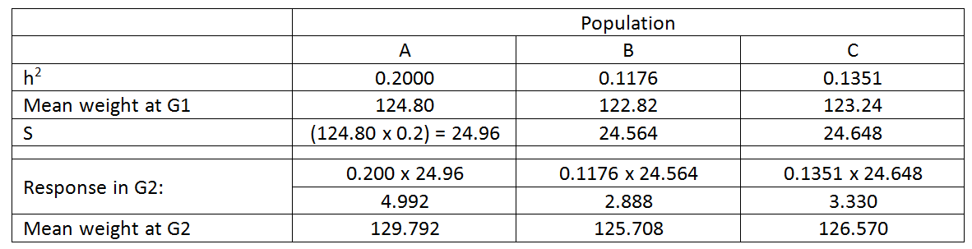
In the second generation of selection (G2), S differs because the starting means differ between pops:

Slide 67
In the second generation of selection (G2), S differs because the starting means differ between pops:
But the rest of the calculation is the same:
Weight at G1 (124.8g) + R x (4.992g) = 129.792

Slide 68
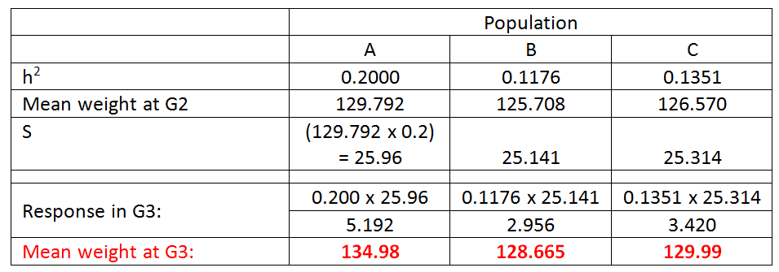
Likewise in G3:

Slide 69
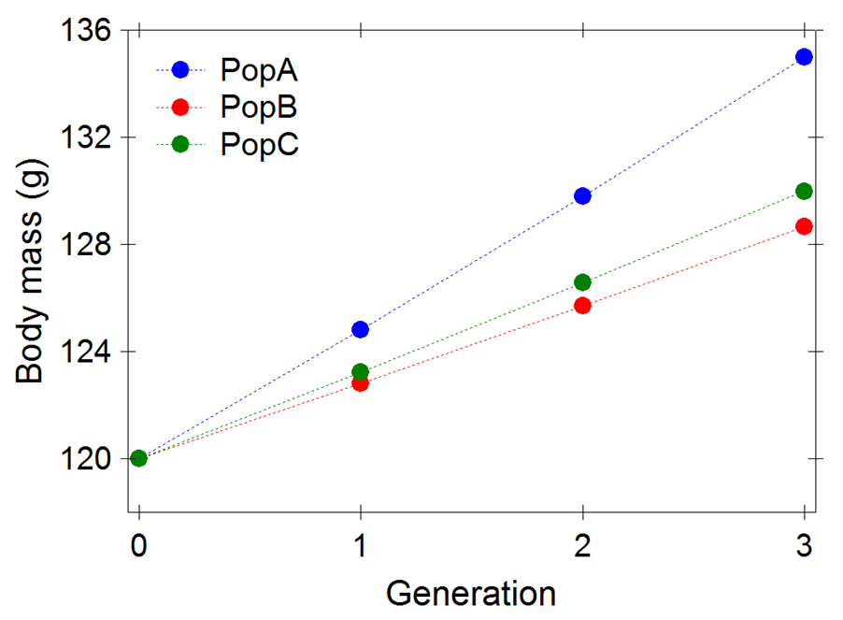
Cumulative effects of selection:
by G50…. Pop A = 852.80g, Pop B = 383.71g, Pop C = 455.12g

Slide 70
h² from parent-offspring
If the environments are standardized, then:
Similarity of parents & offspring:
This directly informs us of the evolutionary potential of the trait… at least if the environmental variance among lines/families is held constant…
Father Son

Slide 71
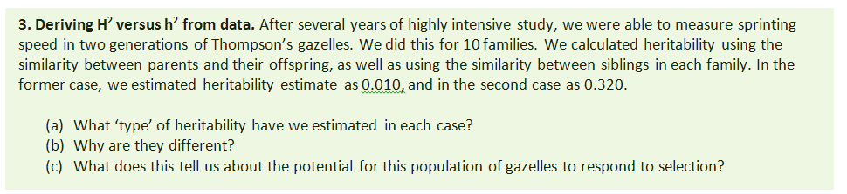

Slide 72
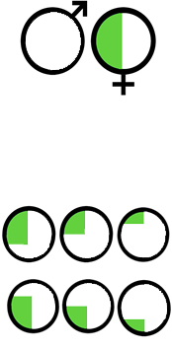
Parents:
Similarity due to V_{A} only
0.5
Offspring
(full sibs):
Similarity due to
V_{A} + V_{D} + V_{I} + V_{E}
0.5

Slide 73
Parents:
0.010 = h²
Similarity due to V_{A} only
Narrow-sense heritability (h²)
0.5
Offspring
(full sibs):
0.320 = H²
Similarity due to
V_{A} + V_{D} + V_{I} + V_{CE}
Broad-sense heritability (H²)
0.5

Slide 74
(b) They are different because our comparisons of parents-offspring versus full-sibs include different sources of variance:
FULL SIBS: Broad sense heritability: H² ~ (V_{A} + V_{D} +V_{I} + V_{E}) / V_{p}
Where:
V_{A} = Additive genetic variance
V_{D} = Dominance variance (interactions between alleles at the same loci)
V_{I} = Interaction variance (or epistasis - interactions between alleles at different loci)
V_{CE} = Common Environment variance (due to the similarity of developmental environments)
PARENT-OFFSPRING: Narrow-sense heritability: h² ~ (V_{A}) / V_{p}
So, h² always ≤ H²

Slide 75
(c) Very low evolutionary potential:
Broad sense heritability: H² ~ (V_{A} + V_{D} +V_{I} + V_{E} ) / V_{p}= 0.320
Where:
V_{A} = Additive genetic variance
V_{D} = Dominance variance (interactions between alleles at the same loci)
V_{I} = Interaction variance (or epistasis - interactions between alleles at different loci)
V_{CE} = Common Environment variance (due to the similarity of developmental environments)
Narrow-sense heritability: h² ~ (V_{A}) / V_{p} = 0.010
R = h²S

Slide 76
Heritability Summary
Broad Sense
V_{P} = V_{G} + V_{E}
H² = V_{G}/V_{P}
ESTIMATED WITH SIBS
Narrow Sense
V_{P} = V_{G} + V_{E}
V_{G} = V_{A} + V_{D} + V_{I}
h² = V_{A}/V_{P}
ESTIMATED PARENT-OFFS
USED IN BREEDERS EQN
R = h²S
V_{P} = phenotypic variance
V_{E} = environmental variance
V_{G} = genotypic variance
V_{A} = additive genetic variance
V_{I} = epistatic genetic variance
V_{D} = dominance genetic variance
H² = broad heritability
h² = narrow heritability

